Slide 1
Statistical Natural Language Parsing
Two views of syntactic structure

Slide 2
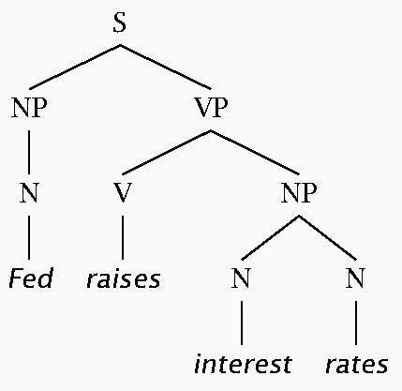
Two views of linguistic structure: 1. Constituency (phrase structure)
Phrase structure organizes words into nested constituents.
How do we know what is a constituent? (Not that linguists don’t argue about some cases.)
Distribution: a constituent behaves as a unit that can appear in different places:
John talked [to the children] [about drugs].
John talked [about drugs] [to the children].
*John talked drugs to the children about
Substitution/expansion/pro-forms:
I sat [on the box/right on top of the box/there].
Coordination, regular internal structure, no intrusion, fragments, semantics, …

Slide 3
Two views of linguistic structure: 1. Constituency (phrase structure)
Phrase structure organizes words into nested constituents.
How do we know what is a constituent? (Not that linguists don’t argue about some cases.)
Distribution: a constituent behaves as a unit that can appear in different places:
John talked [to the children] [about drugs].
John talked [about drugs] [to the children].
*John talked drugs to the children about
Substitution/expansion/pro-forms:
I sat [on the box/right on top of the box/there].
Coordination, regular internal structure, no intrusion, fragments, semantics, …
Notes:
Use Fed raises interest rates example.

Slide 4
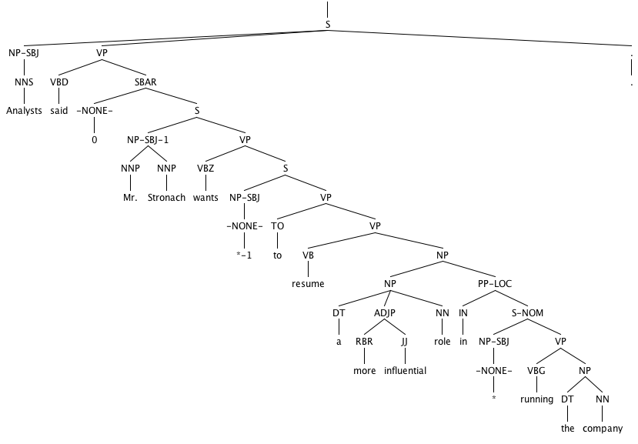

Slide 5
Headed phrase structure
VP → … VB* …
NP → … NN* …
ADJP → … JJ* …
ADVP → … RB* …
SBAR(Q) → S|SINV|SQ → … NP VP …
Plus minor phrase types:
QP (quantifier phrase in NP), CONJP (multi word constructions: as well as), INTJ (interjections), etc.

Slide 6
Two views of linguistic structure: 2. Dependency structure
Dependency structure shows which words depend on (modify or are arguments of) which other words.
put
boy
tortoise
on
The
the
rug
The
boy
put
the
tortoise
on
the
rug
the

Slide 7
Two views of linguistic structure: 2. Dependency structure
Dependency structure shows which words depend on (modify or are arguments of) which other words.
The boy put the tortoise on the rug

Slide 8
Statistical Natural Language Parsing
Two views of syntactic structure

